Slide 1
GenAI Hackathon
Oracle Transportation Management Assistant
October 28, 2024
1
Copyright © 2024, Oracle and/or its affiliates

Slide 2
Team 7
InsightLog
From complex logs to intelligent insights—InsightLog: Your partner in smart diagnostics!

Slide 3


PROBLEM STATEMENT
Create a robust solution to streamline the process of analyzing log files to identify errors, determine root causes, and propose probable solutions.
The tool should handle various log file formats, provide actionable insights, and reduce the time needed for manual error diagnosis.

Slide 4

What is our product?
1.Automated Error Detection: Our product scans log files to identify errors, saving time and reducing the risk of overlooking critical issues.
2. Root Cause Analysis: It not only detects errors but also traces back to find the root cause, helping teams understand the underlying problem quickly.
3. Probable Solution Suggestions: Based on the analysis, the tool offers probable solutions, guiding users toward resolving issues more efficiently.
4. Multi-format Support: The product can analyze various log file formats, making it versatile and adaptable across different systems.
5. Efficiency in Resource Allocation: By automating log analysis, the tool reduces the need for manual intervention, freeing up manpower and allowing teams to focus on high-priority tasks.

Slide 5
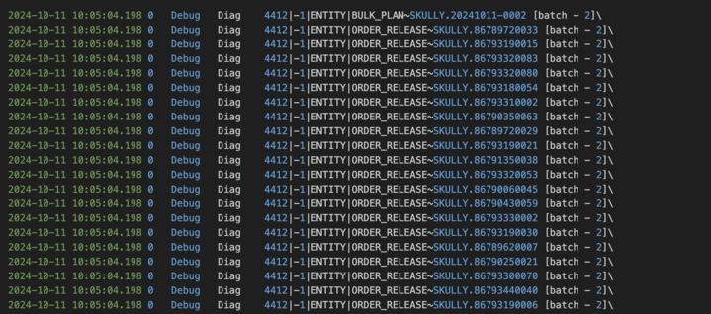

USE CASE : OTM ASSISTANT (Cont.)
Analyzing large sized log files

Slide 6

TOOLS
Log to Json converter
Web Search
Tools
Embedding Creation
Word search
6
Copyright © 2024, Oracle and/or its affiliates | Confidential: Internal/Restricted/Highly Restricted

Slide 7
AI AGENTS
Router Agent
Summarizing Agent
AI
Agents
Grading Agent
Hallucinating Agent
7
Copyright © 2024, Oracle and/or its affiliates | Confidential: Internal/Restricted/Highly Restricted

Slide 8
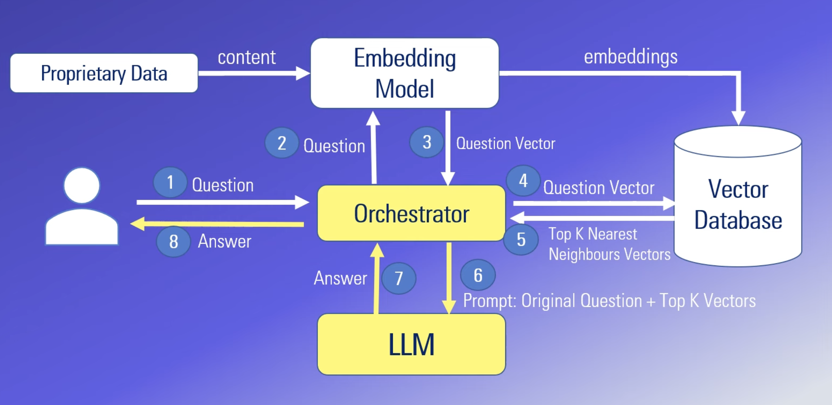
How does RAG work?

Slide 9

MODELS
Mixtral-8x7b-32768 Llama3-70b-8192 Groq
Embedding Model
FastEmbed Embedding
“BAAI/bge-base-en-v1.5”
Summarizing Model
“t5-small” summarizing model from Hugging Face
9
Copyright © 2024, Oracle and/or its affiliates
Notes:
AI Agent is a piece of software program/ application that orchestrates and automates the tasks
It becomes more sophisticated by implementing ReAct model that combines reasoning and actions
Key aspects is to leverage LLM as a reasoning engine that determines which action to take in which order.

Slide 10
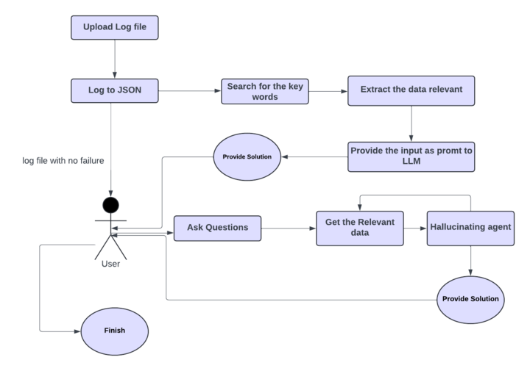
OVERALL WORKFLOW
10
Copyright © 2024, Oracle and/or its affiliates | Confidential: Internal/Restricted/Highly Restricted

Slide 11
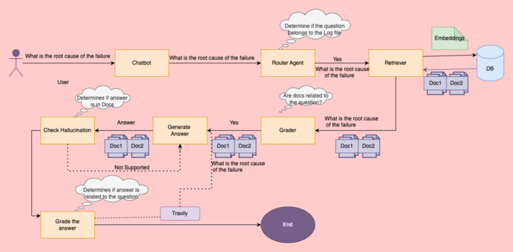
CHATBOT WORKFLOW
11
Copyright © 2024, Oracle and/or its affiliates | Confidential: Internal/Restricted/Highly Restricted

Slide 12
DEMO

Slide 13
FUTURE ASPECTS
Make it more Scalable
Implement Department based log conversion tool
Store past queries for reference
Integrate a feedback loop for continuous improvement
Predict the further failure of the shipment from their predecessors

Slide 14
TEAM CONTRIBUTION
Shashank V
Vidhya M H
Nishal H N
Suteerth I
Roshan R
Model Building
Building Agents
Modifying one tool
Backend
Building agents
Json tool converter
Created UI, using Streamlit
Model integration with the frontend
Research
Model Building
Building Agents
Agents Workflow
Research on RAG
UI Frontend
14
Copyright © 2024, Oracle and/or its affiliates
Notes:
Our first few releases have focused on agent productivity and as you can see it covers all areas of service –
Agent facing service center,
Chats
Knowledge authoring
Generating troubleshooting interviews that can be incorporated in service workflows

Slide 15
Thank You…

